Slide 1
Chapter4: Local Search

Slide 2
Local Search
Local search and optimization problems
Local search algorithms
Hill climbing
Simulated annealing
Local beam search
Genetic algorithms

Slide 3
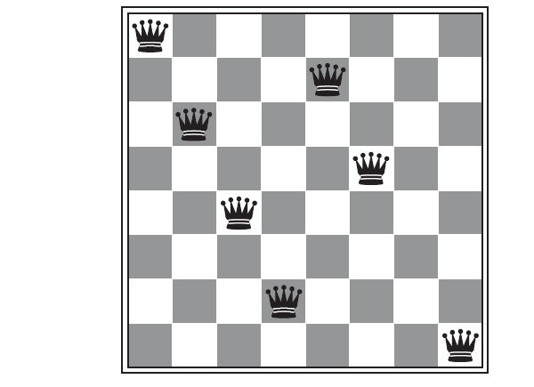
Local Search
The search algorithms studied so far keep one or more paths in memory and record which alternatives have been explored at each point along the path.
When a goal is found, the path to that goal also constitutes a solution to the problem.
However, for many problems all that matters is the goal state itself, not the path to reach it.
For example, for the n-queen problem what matters is the final configuration of queens, not the order in which they are added.
Notes:
The search algorithms that we have seen so far are designed to explore search spaces systematically.
This systematicity is achieved by keeping one or more paths in memory and by
recording which alternatives have been explored at each point along the path. When a goal is
found, the path to that goal also constitutes a solution to the problem.
Put n queens on an n × n board with no two queens on the
same row, column, or diagonal

Slide 4
Local Search
Local search algorithms are suitable for problems where the path to the goal does not matter.
Local search algorithms operate using a single current node (rather than multiple paths) and generally move only to the neighbors of that node.
The paths followed by the search are not retained.
Local search algorithms are useful for solving pure optimization problems (find the best state according to an objective function).
On the other hand, maximizing/minimizing an objective function cannot fit using Chapter 3 search algorithms as there is no goal test.

Slide 5
Advantages of Local Search Algorithms
They use very little memory—usually a constant amount
They can often find reasonable solutions in large or infinite (continuous) state spaces for which systematic algorithms are unsuitable.

Slide 6
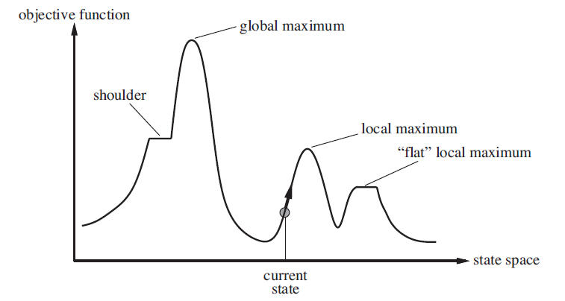
State Space Landscape
Notes:
The goal is to find a global minimum/maximum.
A complete local search algorithm always finds a goal if one exists; an optimal algorithm always finds a global minimum/maximum.

Slide 7
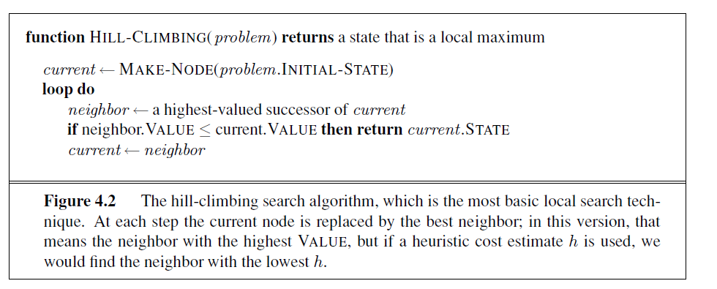
Hill-climbing Search

Slide 8
Hill-climbing Search
It continually moves in the direction of increasing value until it reaches a “peak” where no neighbor has a higher value.
The algorithm does not maintain a search tree, for the current node it only saves the state and the value of the objective function.
Hill climbing is sometimes called greedy local search because it grabs a good neighbor state without thinking ahead about where to go next.

Slide 9
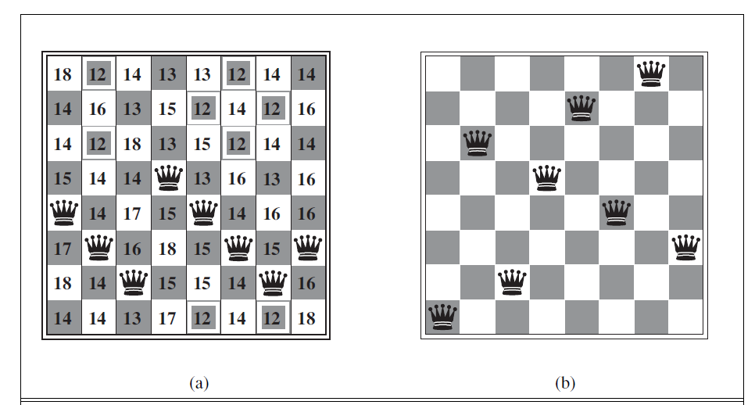
Example: n-queen problem
The heuristic cost function h is the number of pairs of queens that are attacking each other, either directly or indirectly.
h=17
h=1
Notes:
The successors of a state are all possible states
generated by moving a single queen to another square in the same column (so each state has
8*7=56 successors). The heuristic cost function h is the number of pairs of queens that
are attacking each other, either directly or indirectly.
The right figure h=1, is a local minimum.

Slide 10
Hill-climbing Search
Hill climbing gets stuck due to:
– Local maxima/minima A peak that is higher than each of its
neighboring states, but lower than the
global maximum.
– Plateau (shoulder or flat local maxima/minima)
A plateau is a flat area of the state-space landscape.

Slide 11
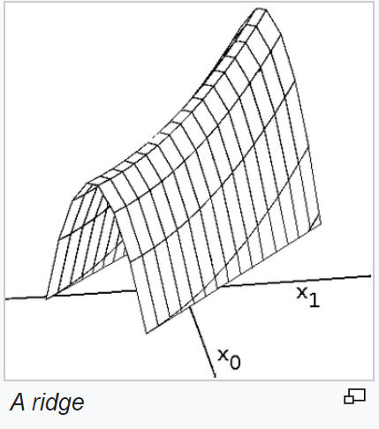
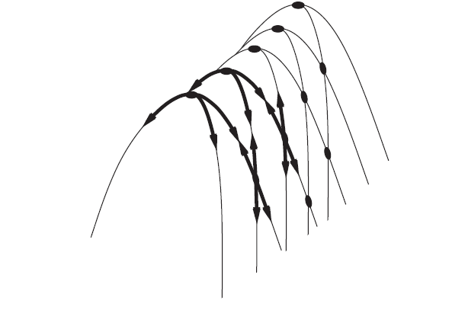
Hill-climbing Search
Ridges
Ridges result in a sequence of local maxima
that is very difficult for greedy algorithms to navigate.
The grid of states is a sequence of local maxima that are not directly
connected to each other.
From each local maximum, all the available actions point downhill.
Notes:
Ridge: Any point on a ridge can look like a peak because the movement in all possible directions is downward. Hence, the algorithm stops when it reaches such a state. To overcome Ridge: You could use two or more rules before testing. It implies moving in several directions at once.
The \ridge" creates a sequence of local maxima that are not
directly connected to each other. From each local maximum, all
the available actions point downhill.
It is region which is higher than its neighbours but itself has a slope. It is a special kind of local maximum.

Slide 12
Hill climbing search-example
Starting from a randomly generated 8-queens state, hill climbing gets stuck 86% of the time,
solving only 14% of problem instances.
It works quickly, taking just 4 steps on average when it succeeds and 3 when it gets stuck.
These results are not bad for a state space with 8⁸ ≈ 17 million states.

Slide 13
Hill Climbing Search
May allow sideway move, this could help if plateau is really a shoulder.
But what if there is no uphill movements?
Put a limit on the number of consecutive
sideways moves allowed.
This raises the percentage of n-queen
problem instances solved by hill climbing from
14% to 94%.
Success comes at a cost: After allowing sideway moves, the algorithm has on average
roughly 21 steps for each successful instance and 64 for each failure.

Slide 14
Variants of Hill Climbing Search
Stochastic hill climbing
– chooses at random from among uphill moves
– converges more slowly, but finds better solutions in some landscapes
First-choice hill climbing
– generate successors randomly until one is better than the current
– good when a state has many successors
Random-restart hill climbing
– conducts a series of hill climbing searches from randomly generated
initial states, stops when a goal is found
– It’s complete with probability approaching 1
Notes:
Random restart adopts the well-known quote, “If at first you don’t succeed, try, try again.” It
It is trivially complete with probability approaching 1, because it will eventually
generate a goal state as the initial state. If each hill-climbing search has a probability p of
success, then the expected number of restarts required is 1/p. For 8-queens instances with
no sideways moves allowed, p ≈ 0.14, so we need roughly 7 iterations to find a goal (6 failures
and 1 success). The
Random restart Hill climbing
Even for three million
queens, the approach can find solutions in under a minute

Slide 15
Simulated annealing
A hill-climbing algorithm that never makes “downhill” moves toward states with lower value
(or higher cost) is incomplete, because it can get stuck on a local maximum.
In contrast, a purely random walk that is, moving to a successor chosen uniformly
at random is complete but extremely inefficient.
What about combining both completeness and efficiency?
Simulated annealing algorithm combines both.

Slide 16
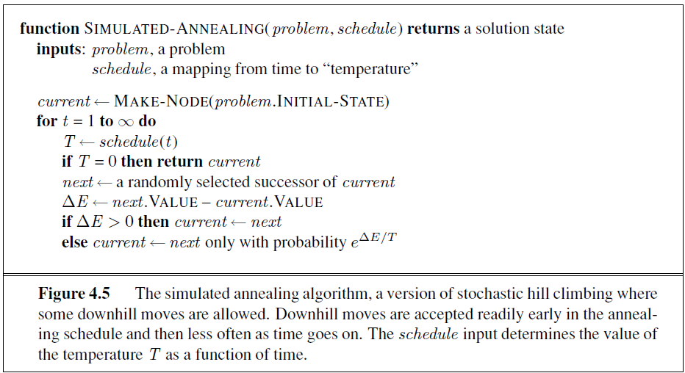
Simulated annealing
Picks a random move
Always accept the move if is better.

Slide 17
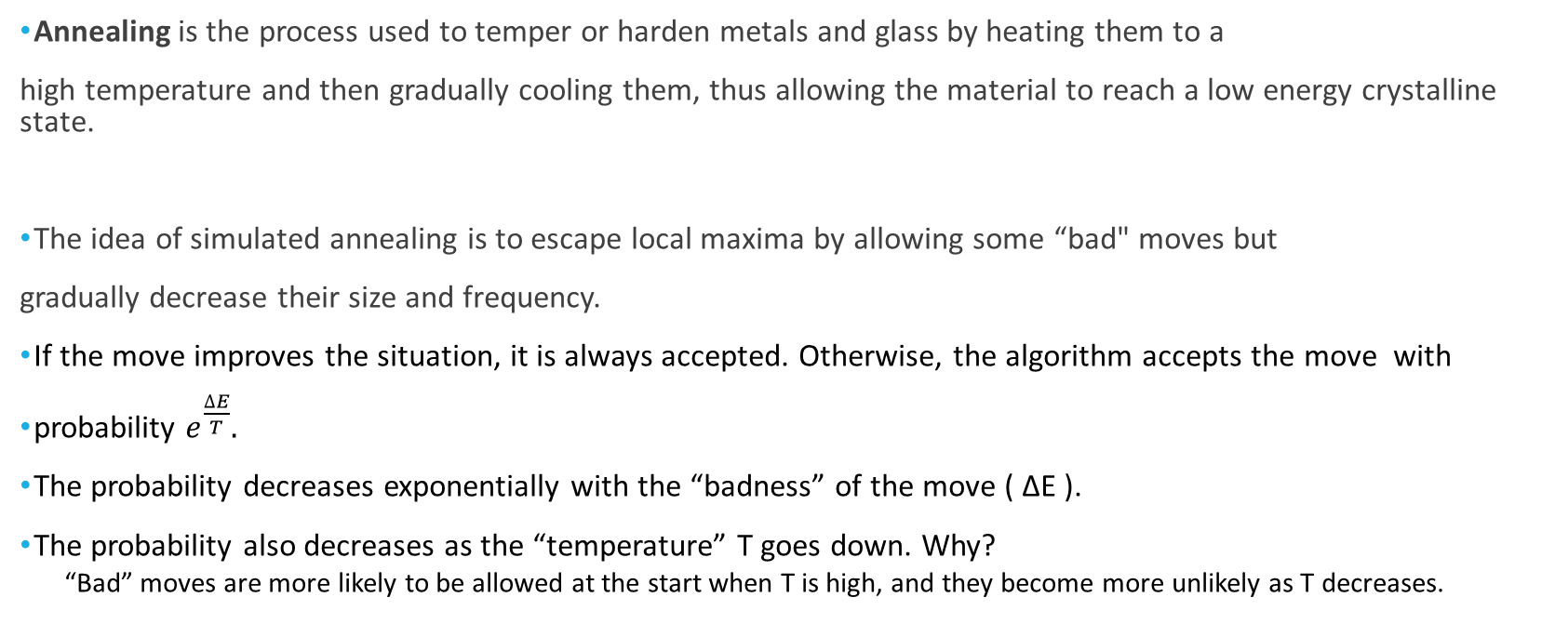
Simulated annealing
Annealing is the process used to temper or harden metals and glass by heating them to a
high temperature and then gradually cooling them, thus allowing the material to reach a low energy crystalline state.
The idea of simulated annealing is to escape local maxima by allowing some “bad" moves but
gradually decrease their size and frequency.
If the move improves the situation, it is always accepted. Otherwise, the algorithm accepts the move with
probability $e^{\frac{∆E}{T}}.$
The probability decreases exponentially with the “badness” of the move ( ΔE ).
The probability also decreases as the “temperature” T goes down. Why?
“Bad” moves are more likely to be allowed at the start when T is high, and they become more unlikely as T decreases.
Notes:
If the move
improves the situation, it is always accepted. Otherwise, the algorithm accepts the move with
some probability less than 1. The probability decreases exponentially with the “badness” of
the move—the amount ΔE by which the evaluation is worsened. The probability also decreases
as the “temperature” T goes down: “bad” moves are more likely to be allowed at the
start when T is high, and they become more unlikely as T decreases.

Slide 18
Simulated Annealing
If T decreases slowly enough, then simulated annealing search will find a global optimum with probability approaching 1.
Widely used in VLSI layout, airline scheduling, etc.

Slide 19
Local beam search
Keep track of k states rather than just one
Start with k randomly generated states.
At each iteration, all the successors of all k states are generated.
If any one is a goal state, stop; else select the k best successors from the complete list and repeat.
Is it the same as running k random-restart searches?
No, in a random-restart search, each search process runs independently of the others.
In contrast, in local beam search, useful information is passed among the k parallel search threads.

Slide 20
Local beam search
Local beam search can suffer from a lack of diversity among the k state as they can quickly become concentrated in a small region of the state space.
Stochastic beam search chooses k successors at random, with the probability of choosing a given successor being an increasing function of its value.

Slide 21
Genetic algorithms
A genetic algorithm (or GA) is a variant of stochastic beam search in which successor states
are generated by combining two parent states rather than by modifying a single state.
Like beam searches, GAs begin with a set of k randomly generated states, called the
population.
A state is represented as a string over a finite alphabet (often a string of 0s and 1s or digits).
Evaluation function (fitness function) has higher values for better states.
The probability of being chosen for reproducing is directly proportional to the fitness score.
Produce the next generation of states by selection, crossover, and mutation.

Slide 22
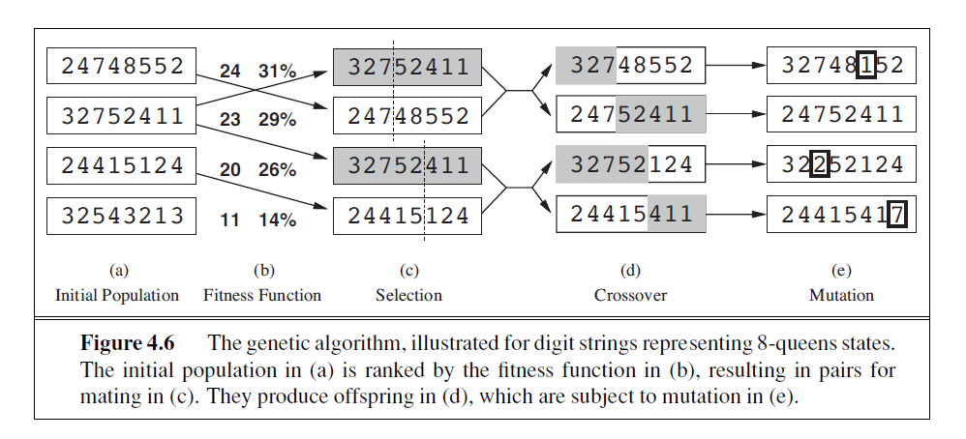
Genetic algorithms: n-queens example
Crossover points
Notes:
we use the number of nonattacking pairs of queens, which has a value of 28 for a solution

Slide 23
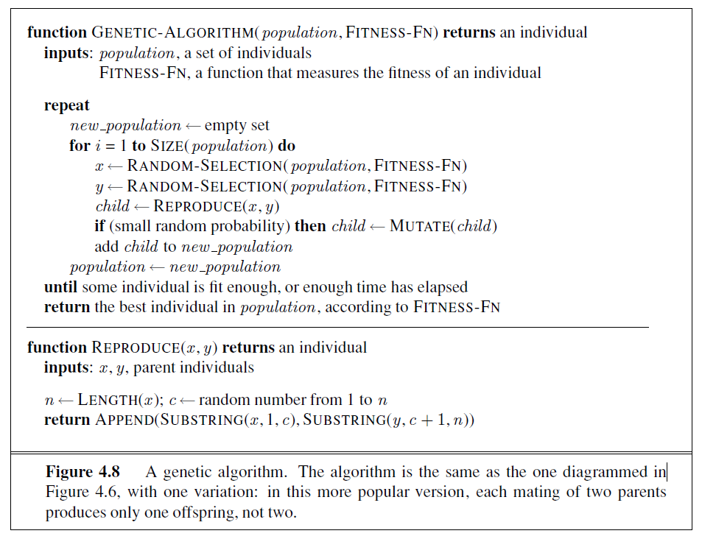
Genetic algorithms

Slide 24
Genetic Algorithms
Like stochastic beam search, genetic algorithms combine an uphill tendency with random
exploration.
The population is generally quite diverse early on in the process, so crossover (like simulated annealing) frequently takes large steps in the state space early in the search process and smaller steps later on when most individuals are quite similar.
Genetic algorithms are used in optimization problems such as circuit layout and job-shop scheduling.
Notes:
For
example, it could be that putting the first three queens in positions 2, 4, and 6 (where they do
not attack each other) constitutes a useful block that can be combined with other blocks to
construct a solution.

Slide 25
Section 4.1 from Chapter 4 of the textbook.

